Slide 1


SAP S/4HANA Training
MASTER DATA GOVERNANCE (SAP MDG)
Neeraj Gupta
Session 12
SAP MDG – Derivations

Slide 2
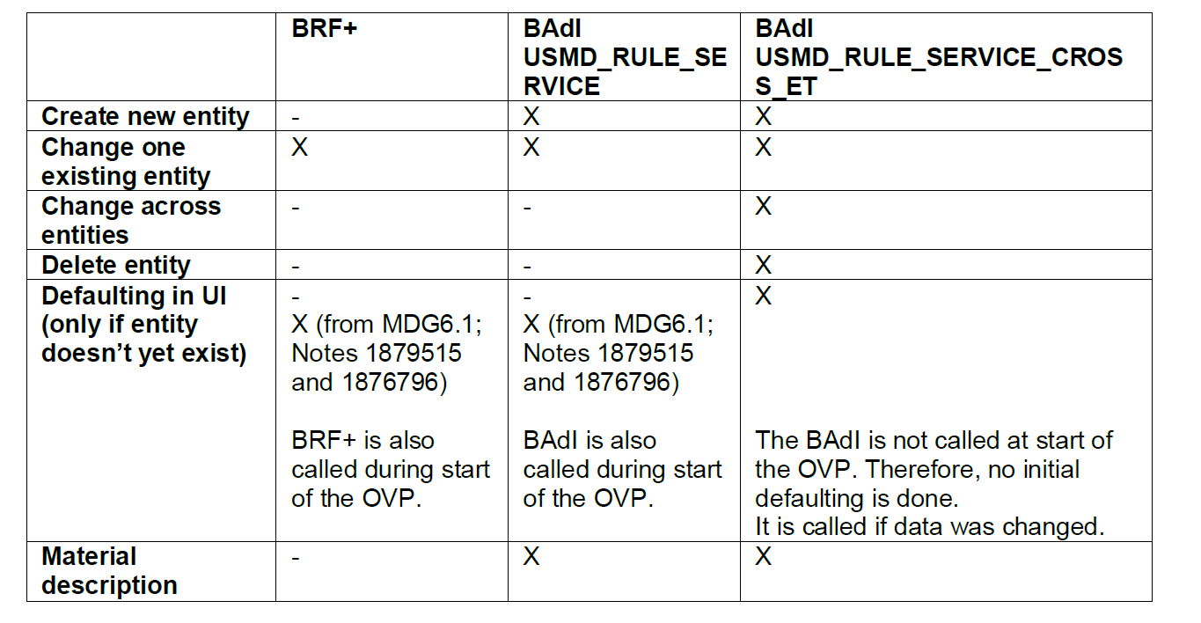
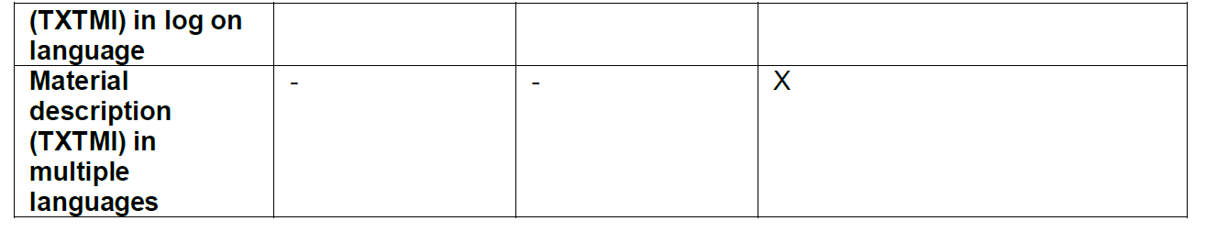
12
SAP MDG – Derivations, BADIs
Comparison of Derivations

Slide 3
12
SAP MDG – Derivations, BADIs
BADIs and methods in derivations
Change Request Enrichment BADI (MDG_BS_MAT_API_ENRICH_BADI)
Automatically fill in fields from the material master that are not subject to master data governance.
• The changes to the data have no impact on the UI
• This BAdI will only be called during activation, when the data is being transferred back to the active area. Therefore, use only technical error messages, no business checks.
SMT-Mapping Staging → Active Area
Automatically fill in fields from the material master that are not subject to master data governance.
• The changes to the data have no impact on the UI
• These defaults are considered during activation and the various checks
• No messages possible
• Use case: To fill in mandatory fields those are not part of the MM data model. For example, to automatically fill in the cross-plant material status with a fixed value (EhP6)

Slide 4
12
SAP MDG – Derivations,, BADIs
Cross-Entity Rules (USMD_RULE_SERVICE_CROSS_ET)
Example for entity MARASALES with 1:1 relation:
Entities MATERIAL and MARASALES for the derivation DERIVE_MARASALES

Slide 5
12
SAP MDG – Derivations,, BADIs
Cross-Entity Rules (USMD_RULE_SERVICE_CROSS_ET)
Use case: Define Defaults

Slide 6
12
SAP MDG – Derivations,, BADIs
Execution Time (Derive Entity from BRF+ Rules and Derivation BADI )

Slide 7
12
SAP MDG – Derivations,, BADIs
Examples of defaulting

Slide 8
12
SAP MDG – Derivations,, BADIs
Decision Table with multiple results

Slide 9
12
SAP MDG – Derivations,, BADIs
Scenario:
The Period Indicator (MARC-PERKZ) should be defaulted as in the backend (FM MARC_ADD_REFERENCE_AFTER)

Slide 10
12
SAP MDG – Derivations,, BADIs
Scenario:
The Procurement Type (MARC-BESKZ) should be defaulted as in the backend
Solution:
Create a ruleset for function DERIVE_MARCMRPSP.
Create rules for exit conditions and create the following rule for defaulting: if material type is not initial then change procurement type according to decision table.

Slide 11

End of Session 12

Slide 12

Questions

Slide 13

Neeraj gupta

Slide 14


We’re committed to empower you to be
Most Desirable Resource
through powerful training solutions.
We build the workforce of the future.
250+
Corporate Clients
30,000+
Learners Trained
25000+
Learners Placed
FREE WEBINARS
Sign up for free webinars with industry experts every fortnight!
Enroll Now!
Contact us today!
https://anubhavtrainings.com/

Slide 15




More from AnubhavTrainings.com

